Slide 1

Digitalizing cash Management
NCR Hackathon 2023
Team: ATM sQuad

Slide 2




Meet Our Team
Ashwath Kumar
Manish Kumar
Vinutha Kananthoor
Ragavendra Kurudi

Slide 3

Problem Statement
Loading cash into ATM has many manual touch points.
Its very hard to track the cash loading process.
Takes more time to complete the settlement.

Slide 4


Introduction
Digitalizing the manual touch points of cash loading into ATM.
Real-time Cash movement Monitoring: The app provides real-time visibility into the cash movement at each ATM within the network
There is option to upload image in each step of cash loading process.
Incident Reporting: In case of any issues during cash loading, such as technical problems or security breaches, the app allows operators to report incidents promptly.

Slide 5
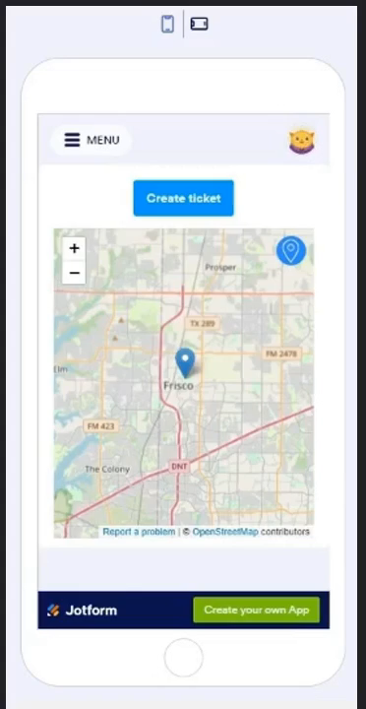
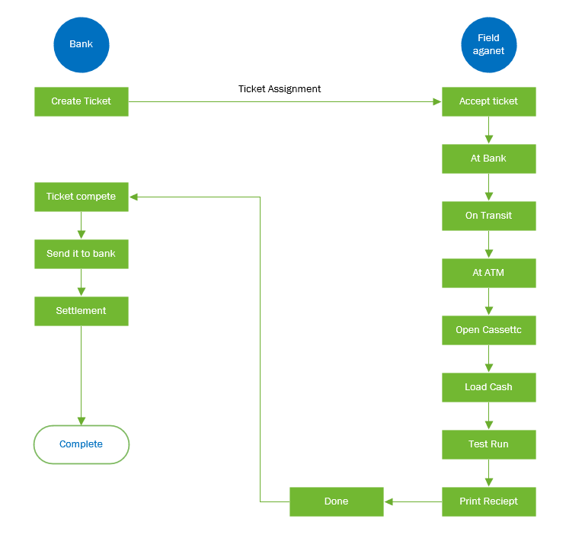
Solution

Slide 6

Benefits
Bank can Track the Field Agent’s location
Cash loading in the ATM can be tracked
Incident is created if any issue occurs
Access to the system is secure
Real time tracking

Slide 7

Future Enhancement
Cloud system
Exposing API end points to connect with other system.
Dynamic Key generation process to enhance security for opening the ATM.

Slide 8
Thank You

